Slide 1
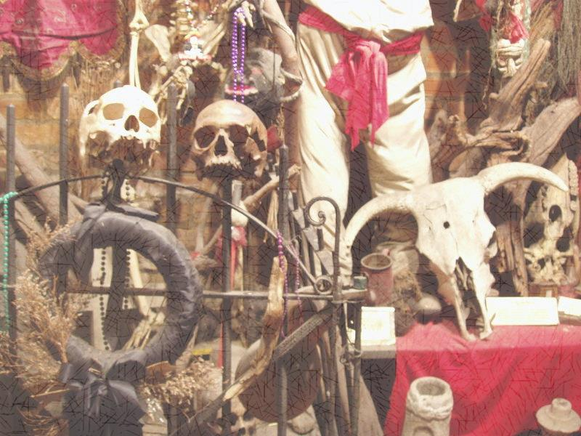
VooDoo
Beliefs and traditions

Slide 2
What is Voodoo?
VooDoo (also Vodun, Vodou) is an ancient syncretic denomination combining traditional African beliefs with Christian religious faiths.
VooDoo originates in Africa, namely the modern territory of Benin, and was carried to the New World by African slaves. Thus, in America, voodoo is believed to combine traditions of Catholic, African and Native American beliefs.
Voodoo is practiced worldwide, though the exact number of Voodooists is unknown. (Haas) The best-known are African, Haitian and Louisiana Voodoo.
It is a religion of spirits.

Slide 3
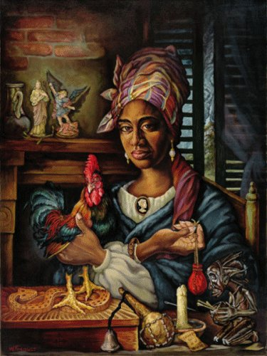
Hierarchy in Voodoo:
There is no leader for all the voodoo adepts around the world
Community-centered religion
No scripture
Traditions vary from community to community
There is ordained clergy: Voodoo priests are Houngans (male), Mambos (female) (are chosen by the spirits; conduct ceremonies)

Slide 4
Beliefs and views: God, Jesus, and the Holy Spirit; creation
Similar to Catholics, Voodooists believe in a single supreme god called Bondye (the good god). (Beyer) He is in charge of the universal order and all the human activities.
Bondye is a remote deity, the origin of life who created the whole world
Loa are the deities closer to people who take part in their daily life. Loa can be compared with saints in Christianity.
Three-tier system: 1st – the supreme God, 2nd – loa, the spirits of the diseased relatives, 3rd – mortals. (Kelly)

Slide 5
Beliefs and views: rituals and worship
Ancient traditions of ancestor worship and animism (Handwerk)
Ceremonies are opened with the invocation of the Trinitarian God: Danbhalah Wedo, Aїda Wedo and Legba (Felix). They contain ritual dancing and prayers
The ceremonies are fully participatory with not only a houngan or a mambo participating but everyone present (Corbett)
Loa are believed to “mount” the participants of the rituals (take over their bodies for a while)

Slide 6
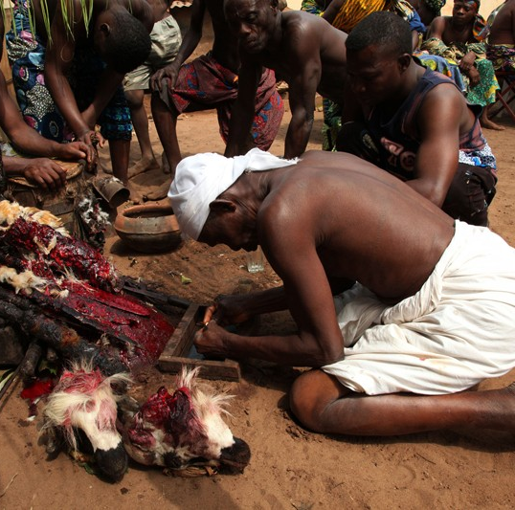
Beliefs and views: rituals and worship
Each Voodoo ceremony includes animal sacrifice aimed at re-juvenating and restoring the power of loa (Corbett). Killed animals are often cooked and served as a part of the service (Kelly).
Rituals involve drawing spiritual symbols with powder (e.g. cornmeal). Each loa has its own sign (Beyer).

Slide 7
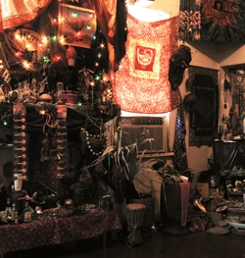
Beliefs and views: rituals and worship
Poking pins into Voodoo dolls are a myth, this practice is not reflected in rituals.
Temples are usually family heritage and may differ depending on the instructions received from the certain loa (Felix).

Slide 8
Beliefs and views: life after death and personal salvation
Voodoists believe there are two worlds: visible and invisible. As a person passes away he/she is believed to transfer to the invisible world, the world of spirit. Thus, Voodooists believe that the spirits of their relatives stay nearby and give high priority to honoring the spirits of ancestors. Vilokan is the home for spirits of the deceased and loa (Beyer).
Similar to Christianity, Voodoo adherents must comply with the demands of spirits from which they ask help in order to achieve success and salvation.

Slide 9
Beliefs and views: health and healing
Healing is an integral part of Voodoo practices. Most rituals are aimed at healing the injured or sick (Kelly).
Voodoo priests can focus either on healing a person’s spirit (e.g. broken heart) or a person’s body (Kelly).
Nevertheless, priests are not almighty, that’s why voodooists accept modern medicine methods and traditions if they cannot cope with their illnesses with help of rituals.

Slide 10
Social hierarchy and ethics
In terms of religion, men and women are equal in their meaning as both women and men can be ordained and perform ceremonies.
All the members of the community are to contribute to its prosperity and enrichment.

Slide 11
Reference list:
Beyer, Catherine. Bondye, the Good God of Vodou, Retrieved July 6 from: http://altreligion.about.com/od/mythologicalfigures/p/bondye.htm
Beyer, Catherine. Vodou, an Introduction for Beginners, Retrieved July 6 from: http://altreligion.about.com/od/alternativereligionsaz/p/vodou.htm
Corbett, Bob. Introduction to Voodoo in Haiti, Retrieved July 6 from: http://www2.webster.edu/~corbetre/haiti/voodoo/overview.htm
Felix, Emmanuel, Jr.. Understanding Haitian Voodoo, Retrieved July 6 from: http://books.google.com.ua/books?id=1a6wS-DOac0C&printsec=frontcover&dq=voodoo&hl=ru&sa=X&ei=v-u2U4inCuuv7AbViIHYDQ&ved=0CEIQ6AEwBQ#v=onepage&q=voodoo&f=false
Haas, Saumya Arya. What is Voodoo? Understanding a Misunderstood Religion, Retrieved July 6 from: http://www.huffingtonpost.com/saumya-arya-haas/what-is-vodou_b_827947.html
Handwerk, Brian. Voodoo a Legitimate Religion, Anthropologist Says, Retrieved July 6 from: http://news.nationalgeographic.com/news/2002/10/1021_021021_taboovoodoo.html
Kelly, Debra. 10 Things You Didn’t Know About Voodoo, Retrieved July 6 from: http://listverse.com/2013/12/11/10-things-you-didnt-know-about-voodoo/

